Slide 1
Moldova: Policy and business advice for eProcurement reforms
Chisinau, November 7-8th 2019

Slide 2
Workshop objectives
Presentation of the EBRD technical cooperation project, status of the work in progress and results achieved so far in piloting
Understand the objectives of the European Union technical assistance and facilitate providing all necessary information and assistance to undertake a review of the MTender system to provide inputs for decision-making in respect to future development
Showcase MTender as an example of open source & open data electronic public procurement and its associated benefits of standardised, transparent and efficient ‘end-to-end’ public procurement process

Slide 3
Workshop agenda
Thursday 7th November
Day 1
Introduction of EBRD reform project, alongside with the main principles of the eProcurement reform, the legislative propositions for adoption of electronic procurement and the MTender pilot
Friday 8th November
Day 2
Presentation of the MTender pilot Implementation Phase 2 system pilot in detail and the document repository of the EBRD TC reform

Slide 4
Workshop agenda – 1st Day
Thursday 7th November
9.15 – 9.30 | Moderator: TBC by the EU Delegation Introduction of the meeting participants and the EU project
9.30 – 10.00 | Presentation of the project team, scope and work progress on piloting Mtender Xavier Quer, everis Reform objectives Stakeholders involved
10.00– 11.00 | Details of work progress - Business concept of the eProcurement reform Daniel Arosa, everis Reform concept Reform principles Main pillars of the reform
11.00 – 11.30 | Coffee break
11.30 – 13.00 | Details of work progress – Regulatory reform – legal framework required for end-to-end eProcurement Dorina Harcenco, EBRD, Andrei Rogac, EBRD Baseline situation Harmonisation with EU acquis and GPA terms Secondary legislation implemented
13.00 – 14.30 | Lunch break
14.30 – 16.30 | Details of work progress – technology – open networking multi-platform electronic public procurement Xavier Quer, everis; Daniel Arosa, everis MTender concept Main key aspects of MTender MTender architecture
16.30 – 17.00 | Questions and answers Xavier Quer, everis

Slide 5
EU Delegation assistance project
Presentation by the EU Delegation

Slide 6
Workshop agenda – 1st Day
Thursday 7th November
9.15 – 9.30 | Moderator: TBC by the EU Delegation Introduction of the meeting participants and the EU project
9.30 – 10.00 | Presentation of the project team, scope and work progress on piloting Mtender Xavier Quer, everis Reform objectives Stakeholders involved
10.00– 11.00 | Details of work progress - Business concept of the eProcurement reform Daniel Arosa, everis Reform concept Reform principles Main pillars of the reform
11.00 – 11.30 | Coffee break
11.30 – 13.00 | Details of work progress – Regulatory reform – legal framework required for end-to-end eProcurement Dorina Harcenco, EBRD, Andrei Rogac, EBRD Baseline situation Harmonisation with EU acquis and GPA terms Secondary legislation implemented
13.00 – 14.30 | Lunch break
14.30 – 16.30 | Details of work progress – technology – open networking multi-platform electronic public procurement Xavier Quer, everis; Daniel Arosa, everis MTender concept Main key aspects of MTender MTender architecture
16.30 – 17.00 | Questions and answers Xavier Quer, everis

Slide 7
Session objective
To present the EBRD Technical Cooperation program, including its objectives and achievements
1
To present the roadmap of the EBRD Technical Cooperation and the main outputs
2
To present the EBRD TC teams and relevant stakeholders
3

Slide 8


Policy and business advice for eProcurement reforms
Public Procurement, is the one of the world’s largest market, providing it with great potential benefits but also clear barriers to brining in innovative reforms such as digital procurement.
Barriers to Public Procurement Reform
Benefits of Digital Transformation
Government officials often see high transparency negatively
Inertia and vested interests block change
Can help promote sustainable development goals of environmental protection, social impact, and economic development
Supports greater transparency and decreases corruption
Promotes more efficient systems and therefore reduces wasteful or redundant processes.
Advances in Digital Procurement
EBRD Legal Transition Programme and UNCITRAL identified best practices in e-procurement with the objective of standard setting.
Global procurement leaders like Chile, Brazil, Korea, Paraguay, Portugal, and Ukraine are already embracing highly transparent automatized digital procurement systems and open data policies.

Slide 9



Policy and business advice for eProcurement reforms
The Government of the Republic of Moldova aimed at implementing eProcurement reforms in compliance with the 2014 EU Directives on Public Procurement to achieve the following objectives:
Increase transparency and prevent corruption behaviour during end-to-end public procurement cycle*, from pre-tendering to post-tendering
Increase efficiency and value for money in the procurement processes and increase economic operators participation
Reduce transaction costs for all stakeholders, SMEs in particular and ensure a competitive and sustainable eProcurement model
* The report by the UNDP, “Assessment report of corruption risks in public procurement in the Republic of Moldova”, February 2016, highlights among others the need of “preparation of annual procurement plans as well as the regulation of post-award contracting amendments to avoid corruption practices”

Slide 10
Policy and business advice for eProcurement reforms
Objectives of the EBRD technical cooperation project
The EBRD has provided technical assistance to the Government of the Republic of Moldova for achieving the following objectives:
1/
preparation of the concept for eProcurement reforms
2/
preparation of the Reform Implementation Plan
3/
preparation of a draft new section of primary legislation that would underpin the implementation of eProcurement in the national legal framework
4/
preparation and delivery of training on the recommendation on eProcurement
Piloting of a digital eProcurement system (MTender) for:
micro value contracts
three procurement methods
online contracts
5/

Slide 11
Policy and business advice for eProcurement reforms
Next steps for eProcurement
The EBRD promotes that eProcurement reforms maintain open government principles by
1
Keeping open data as an aim alongside the whole public procurement process and open source as a guiding principle
2
Focusing on efficiency and aim at achieving greater value for money, with very efficient eProcurement solutions and processes
Aligning the public procurement practices and supporting systems with international standards, facilitating knowledge exchange with partner countries and guaranteeing interoperability
3
4
Defining end-to-end digital procurement as default practice for all new procedures and processes implemented
Fostering cross-border cooperation in eProcurement development for facilitating innovation, shared services and increased efficiency for both public administrations and economic operators
5

Slide 12
Policy and business advice for eProcurement reforms
Components of the eProcurement reform
The eProcurement reform requires structural transformation of three components:
Legal
Definition of reform concept
Redefinition of business processes (BPMN) for digital service
Definition of change management actions and users’ training activities
Amendments to Public Procurement Law 131
Definition of new secondary legislation
eProcurement
reform
Business
Technology
Create new digital procurement service for public and commercial buyers (MTender)
Implement interoperability within eGovernment services and registers

Slide 13


Policy and business advice for eProcurement reforms
Project roadmap
Preparation of ToR for development of e-procurement system
Preparation of trainings on regulations and reform concept
Review of primary and secondary legislation
January 2016
Beginning of cooperation
Preparation of reform concept
Preparation of implementation plan
July 2019
Initiation of Pilot 3
Implementation
April 2017
Initiation of Pilot 1
Implementation
Review of best practices in e-procurement
October 2018
Initiation of Pilot 2
Implementation

Slide 14

Policy and business advice for eProcurement reforms
Main achievements
Definition of an innovative digital public procurement service based on most advanced global best practice
‘Proof of concept’ pilot for digital service business model for local market in Moldova
Identification and proposal of regulatory framework to support digital end-to-end procurement aligned with the international obligations deriving from the 2012 WTO GPA and 2014 EU Directives
‘Pre-commissioning pilot implementation’ of digital procurement cycle for micro, small and high value of public procurements
Achievements
Digital procurement data access from legacy and new systems for data-driven evidence-based procurement management

Slide 15

Policy and business advice for eProcurement reforms
Key challenges
Adoption of secondary legislation that would foster full capabilities of MTender pilot
Shared development of the MTender system requires close collaboration between CDU developers, NEPPs and government stakeholders, and increased management control
Key challenges

Slide 16
Policy and business advice for eProcurement reforms
Public procurement reform project stakeholders
Key Experts
EBRD - Eliza Niewiadomska
(NiewiadE@ebrd.com)
EBRD Operation Leader
everis - Xavier Quer
(Xavier.quer.pietx@everis.com)
Project Coordinator
Pilvi Takala
(Xavier.quer.pietx@everis.com)
Legal advisor
Dorina Harcenco
(dorina@ppi-ebrd-unicitral.com)
GPA Advisor
everis – Marta Cano
(marta.cano@everis.com)
Project Director
everis – Marta Junque
eProcurement Business Advisor
everis – Ariadna Güell
eProcurement Business Advisor
everis - Daniel Arosa
(daniel.arosa.otero@everis.com)
Procurement Consultant
Non-Key Experts
Ustudio - Paul Boroday
(paul.boroday@gmail.com)
IT Consultant
Tato Urjumelashvili
(tato@ppi-ebrd-uncitral.com)
eProcurement expert
Piotr Biernacki
(Piotr.biernacki@mgx.com.pl)
BPMN Expert Consultant
Andrei Rogac
(andrei@ppi-unicitral.com) Legal Advisor
everis - Enric Staromiejski
(enric.Staromiejski.torregrosa@everis.com)
OCDS Data Model Advisor
Stefan Condrea
(condrea.stefan@gmail.com)
eProcurement expert
everis - Ivette Vilar
(Ivette.vilar.roldan@everis.com)
IT Team
Viktor Nestulia
(vnestulia@open-contracting.org)
Open Contracting Partnership Consultant

Slide 17

COFFEE BREAK

Slide 18
Workshop agenda – 1st Day
Thursday 7th November
9.15 – 9.30 | Moderator: TBC by the EU Delegation Introduction of the meeting participants and the EU project
9.30 – 10.00 | Presentation of the project team, scope and work progress on piloting Mtender Xavier Quer, everis Reform objectives Stakeholders involved
10.00– 11.00 | Details of work progress - Business concept of the eProcurement reform Daniel Arosa, everis Reform concept Reform principles Main pillars of the reform
11.00 – 11.30 | Coffee break
11.30 – 13.00 | Details of work progress – Regulatory reform – legal framework required for end-to-end eProcurement Dorina Harcenco, EBRD, Andrei Rogac, EBRD Baseline situation Harmonisation with EU acquis and GPA terms Secondary legislation implemented
13.00 – 14.30 | Lunch break
14.30 – 16.30 | Details of work progress – technology – open networking multi-platform electronic public procurement Xavier Quer, everis; Daniel Arosa, everis MTender concept Main key aspects of MTender MTender architecture
16.30 – 17.00 | Questions and answers Xavier Quer, everis

Slide 19
Session objective
Introduce the key aspects of the eProcurement reform in Moldova from the policy perspective, including the system coverage and main pillars
1
Present the Networking Multi-platform scheme and the rationale behind the model
2
Present a high-level implementation plan for the reform
3

Slide 20
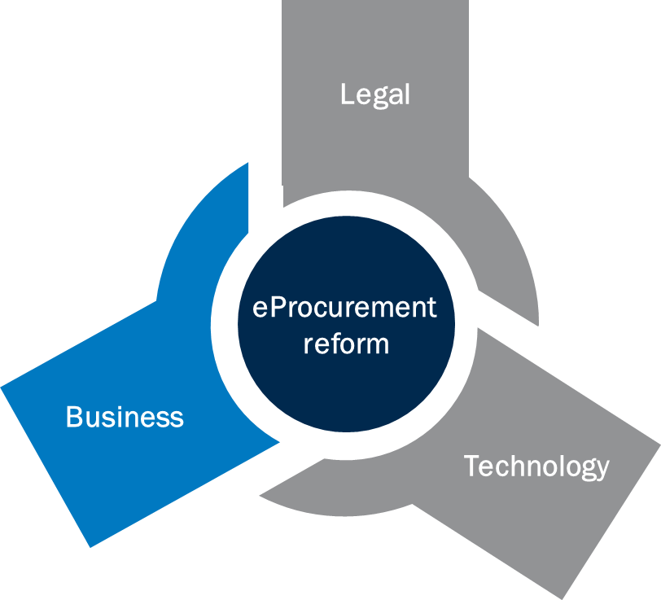
Business concept
Objectives of the component
Analyse the best practices on eProcurement and identify key aspects to have in consideration in the Moldovan eProcurement Reform
Preparation of standardised business processes for the implemented public procurement procedures
Propose a concept reform based on international best practice
Define terms of reference, technical specifications and implementation plan for the eProcurement reform
Provide on-going policy advise

Slide 21






Business concept
Main benefits of eProcurement
What is eProcurement?
Paper-based procedures
are replaced by
Online workflows and electronic tools
Main benefits
1
2
3
Increase transparency
Increase speed and competition of procurement procedures
Reduce transaction costs for public contracts for all stakeholders
Main characteristics
eProcurement procedures are conducted online and recorded for audit in real time – offline elements can be allowed, if needed
Unrestricted and free of charge online access to procurement information
Submission mechanism which enables proposals and offers to be submitted via online interactive form linked to databases
Automatic financial proposal evaluation, with scoring system for technical evaluation available online to the evaluation committee

Slide 22
Business concept
The decision for a networking electronic multiplatform model
A comparative analysis of international best practices was conducted by the EBRD.
Two main alternatives were identified:
Single platform scheme (e.g. Cyprus)
Networking Multi-platform scheme (e.g. Ukraine)
eProcurement Back-end
eProcurement Back-end
eProcurement Front-end
eProcurement
Front-end 1
eProcurement
Front-end N
Contracting Authorities
Economic Operators
CA 1
EO 1
CA N
EO N
Legend
Government operated
Commercial providers
Procurement stakeholders
Notes:
Invite people to came up with two benefits and two downsides of each model

Slide 23


Business concept
The decision for a networking electronic multiplatform model
The following benefits and drawbacks were identified:
Single platform scheme
Networking Multi-platform scheme
Easy end-to-end management of the global procurement process
Simplified integration with other eGovernment systems
Better suited to countries with low eGovernment services maturity
Low development, implementation and maintenance costs
Encourages competition between eProcurement platform providers
Risk is shared between platform suppliers
Platform providers encourage participation of EO in PP processes
Central unit manages and replicates all information to the multiple eProcurement platforms
High initial investment
Single supplier may exploit its monopolistic position
Discourage innovation and future enhancements
High dependency on a single system and a single provider (security breaches, provider drop-out, etc.)
Complex management of the eProcurement environment
Need for a private offer of eProcurement platforms

Slide 24





Business concept
The decision for a networking electronic multiplatform model
The Networking Multi-platform scheme was chosen by the Government of the Republic of Moldova due to the following reasons:
Networking Multi-platform Scheme
Lower costs of implementation and maintenance
Encourages competition between networking electronic procurement platform suppliers
Shared risk between platform suppliers
A Central Database Unit manages and replicates all information to the multiple private platforms
Access to eProcurement platforms is free of charge for contracting authorities
eProcurement Back-end
Central Database Unit
Networking Electronic Procurement Platform
Front-end 1
Networking Electronic Procurement Platform Front-end N
Contracting Authority 1
Economic Operator 1
Contracting Authority N
Economic Operator N
Legend
Government operated
Commercial providers
Procurement stakeholders

Slide 25


Business concept
Coverage of public procurement processes
The system has the aim to cover all public procurement in Moldova. In that sense, it covers all functions from two points of view:
Coverage of public procurement life cycle
Coverage of public procurement procedures
End-to-end electronic procurement
All procedures available by Law

Slide 26
Business concept
Coverage: the procurement life cycle for Moldova
Based on a typical procurement lifecycle, the eProcurement system in Moldova should cover the following:
Pre-tendering
Tendering
Post-tendering
Identification
of needs
Call for bids
or quotes
Contract signature
Receipt of
products or services
Expiration
of guarantee
Tendering
Contract Management
Planning
Preparation
Selection
Execution
Performance management
Reporting and policy analysis
Purchasing
Policy enforcement, review and remedies and audit of procurement function in public sector

Slide 27
Business concept
Coverage: the procurement life cycle for Moldova
MTender aims at covering the entire public procurement life cycle. Furthermore, the system is highly modularised so partial implementations can be foreseen to accommodate different needs
eBudget
ePlanning
eNotices
eComplaint
Budgeting
Plan Annual Procurement
Plan Individual Procurement
Prepare tender documentation
Publish the tender
Request clarifications
Submit complaints
Present bids
eAccess
eClarification
eSubmission
Phase of the procurement lifecycle
Pre-tendering
Tendering
Post-tendering

Slide 28
Business concept
Coverage: the procurement life cycle for Moldova
MTender aims at covering the entire public procurement life cycle. Furthermore, the system is highly modularised so partial implementations can be foreseen to accommodate different needs
eQualification
eAuction
eAwarding
Evaluate performance
Qualify EOs
Evaluate technical offers
Evaluate Financial offers
Award the tender
Sign the contract
Generate invoice and pay the EO
Close the contract
Modify the contract
eEvaluation
eAwarding
Phase of the procurement lifecycle
Pre-tendering
Tendering
Post-tendering

Slide 29
Business concept
Coverage: the procurement procedures in Moldova
The MTender pilot system provides coverage to the following procedures:
All mandatory procedures according to national law and EUPD2014
Open tender
Restricted tender
Request for price quotation
Single source procedure
eAuction could be used in any of these procedures
Included in the MTender pilot
Framework Agreements
Dynamic purchasing system
Market consultations
Negotiation with publication
Negotiation with multiple bidders
Not included in the MTender pilot
Legally compliant BPMN have been already defined for the covered procedures.

Slide 30
Business concept
Main pillars of the eProcurement Reform
MTender should be fully funded from commercial users’ fees for digital procurement services; no initial funding from state budget and no later exposure of state budget is envisaged and no fees are charged to public sector users
Sustainable digital government service
Multi-platform networking model
MTender is a multi-platform, involving Networking Electronic Procurement Platform operators communicating in real time via a central unit with contracting entities and suppliers and the e-government services
Cost-and-time efficient implementation
Open Source Open Data Open Contracting Data Standard
MTender seeks efficiency by a) high-level standardisation of procurement process; b) modular design of electronic workflows; c) the re-use of existing OCDS-based tools and services
MTender is based on open source and fosters transparency and accountability by incorporating Open Data and Open Contracting Data Standard (OCDS)
Key features of the eProcurement model
End-to-end electronic public procurement
High level interoperability
MTender is designed to ensure interoperability with existing and future e-Government services and national public registers
MTender covers the entire public procurement process, from procurement planning to invoicing and payments under public contracts

Slide 31




Business concept
Implementation plan
The approach to the eProcurement Reform Implementation plan is based on 5 axis:
PROCESSES
IT SYSTEMS
Provision of updated, standardised and uniform business process for public procurement which were defined in compliance with regulations and international trade obligations of Moldova. Self-executable BPMN are implemented, which facilitate adoption of public procurement best practices and international trade obligations
eProcurement is necessarily linked to IT solutions that support its different stages and integrate with other e-government services. A pilot of an eProcurement system was implemented, MTender.
The legal framework is a necessary condition for the success of the eProcurement reform. A legal regulatory action plan was defined, enlisting primary and secondary legislation.
A new public procurement governance structure was proposed, which should be able to manage (i) policy and monitoring, (ii) review and remedies, and c) eProcurement governance and interoperability with Networking Electronic Procurement Platforms and eGovernment services.
LEGAL
GOVERNANCE
CHANGE MANAGEMENT
The eProcurement reform requires a change management structure capable of managing a comprehensive change management strategy on training, communication and stakeholders’ engagement.

Slide 32
Business concept
Implementation plan
The eProcurement reform has been designed to be implemented in two stages:
Test the eProcurement system in a low risk environment
Test micro, small and high value procedures
MTender Pilot
Partial implementation of newest eProcurement features
Train users in the use of eProcurement
Full coverage of the public procurement cycle
Connection to government registers
Full Deployment
Full coverage of the public procurement processes
Full integration with eGovernment services
Implementation of aggregated demand mechanisms

Slide 33
Workshop agenda – 1st Day
Thursday 7th November
9.15 – 9.30 | Moderator: TBC by the EU Delegation Introduction of the meeting participants and the EU project
9.30 – 10.00 | Presentation of the project team, scope and work progress on piloting Mtender Xavier Quer, everis Reform objectives Stakeholders involved
10.00– 11.00 | Details of work progress - Business concept of the eProcurement reform Daniel Arosa, everis Reform concept Reform principles Main pillars of the reform
11.00 – 11.30 | Coffee break
11.30 – 13.00 | Details of work progress – Regulatory reform – legal framework required for end-to-end eProcurement Dorina Harcenco, EBRD, Andrei Rogac, EBRD Baseline situation Harmonisation with EU acquis and GPA terms Secondary legislation implemented
13.00 – 14.30 | Lunch break
14.30 – 16.30 | Details of work progress – technology – open networking multi-platform electronic public procurement Xavier Quer, everis; Daniel Arosa, everis MTender concept Main key aspects of MTender MTender architecture
16.30 – 17.00 | Questions and answers Xavier Quer, everis

Slide 34
Session objective
Introduce the key objectives of the Regulatory reform in Moldova
1
Present the baseline situation regarding legal framework and international obligations
2
Provide a detailed overview of the secondary legislation and transposed regulations
3

Slide 35
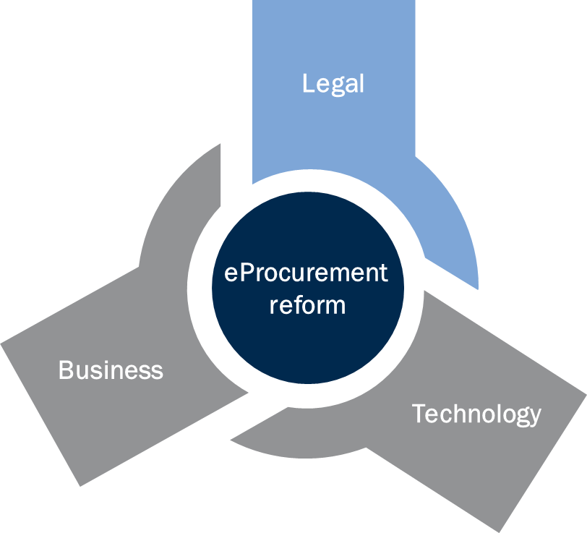
Regulatory reform
Objectives of the component
Review of the current public procurement framework, including primary and secondary legislation
Provision of recommendations for transposition of international obligations of the Republic of Moldova, such as the EU Accession Agreement and WTO GPA
Drafting of precepts to be incorporated in the public procurement law
Drafting of secondary legislation for the adoption of eProcurement and implementation of primary legislation

Slide 36
Regulatory reform
Introduction to legal changes needed
eProcurement concept reform and international agreements vs PPL
Current PPL does not prevent eProcurement concept reform. However, PPL does not identify all planned changes.
Regarding Moldova-EU Association Agreement, PPL fulfils almost entirely the general procurement principles of Article 271.
As regards to WTO GPA responsibilities, there are changes that should be made, for example streamlining the timelines of publishing notices.
Other primary legislation will require assessment, such as: Criminal Records Act and the Act on Openness of Government Activities.
Reform of public procurement rules and secondary legislation is needed for
Following phases and steps of the Association Agreement
EU procurement directives full implementation
Deploy full potential of eProcurement reform

Slide 37
Regulatory reform
Public procurement thresholds
The legal reform is aimed at making the public procurement legal framework more efficient while being compliant with EU Directives and GPA rules
High Value Contracts – international trade thresholds
Procurement
Mandatory to apply all 2012 WTO GPA rules
and 2014 EU Directives
Low Value Contracts– above national public procurement law thresholds
Mandatory to apply the 2014 EU Directives principles: transparency, competition, non-discrimination, and proportionality,
Public
Micro Value Contracts– below public procurement law thresholds
National public finance management regulation may require transparency and competition

Slide 38
Regulatory reform
Changes needed in legal framework
Primary and secondary legislation needs to be redrafted according to the procurement thresholds
Amendments needed
PPL 313
Regulations
Ministerial Orders
Micro value procurement
NO
YES
YES
Small value procurement
NO
YES
YES
Legal thresholds
High value procurement
YES
YES
YES

Slide 39
Regulatory reform
Suggested timeline for change
Regulatory reforms are made in parallel to support eProcurement pilot and full eProcurement system adoption after the reform:
2017
2018
2019
2020
PPL reform
NEW PPL
APR-17
APR-17
SEP-17
JAN-18
APR-18/DEC-19
PPL amendments
Regulations/ orders
Art 2 and 55
Reg/orders
Art 48 and 49 and MTender
Reg/orders
Negotiated procedure Art 53
Changes as considered necessary to regulations and orders

Slide 40
Regulatory reform
Secondary legislation
Several packages of secondary legislation have been drafted under the EBRD TC assistance. Nevertheless, not all secondary legislation has been approved and implemented
Implemented secondary legislation submitted by EBRD TC Team
The regulation on procurements of goods and services conducted through request for price quotation (RfQ) – the adopted version takes into account small parts from the submitted draft regulation and recommendation;
The Standard Bidding Documents for goods, services and works through open tender and RfQ – the adopted versions did not took into account the draft versions submitted by the EBRD TC Team;
The template of the European Single Procurement Document - the adopted versions did not took into account the draft versions submitted by the EBRD TC Team;

Slide 41
Regulatory reform
Secondary legislation
The following secondary legislation has been drafted by the EBRD TC Team but is not currently implemented
Regulation on annual procurement planning – the current version is based on the 2015 text of the PPL;
Regulation on public procurement record and contract register;
Regulation on conducting procurements through electronic framework agreements;
Regulation on procurements conducted by Annex 3 WTO GPA procurement entities;
The Standard Bidding Documents for goods, services and works through open tender and RfQ including the public procurement contract templates;
Regulation on procurements conducted through open tender and restricted tender;
The European Single Procurement Document;

Slide 42
Regulatory reform
Further reforms
The following secondary legislation needs to be adopted:
The ones submitted by EBRD TC Team mentioned in the previous slide;
The regulation on public procurement of works – the current one is from 2016;
Working group and procurement officer regulation - the current one is from 2016;
The regulation on procurements conducted through negotiations - the current one is from 2016;
The regulation on procurements conducted through dynamic purchasing system - the current one is from 2013;
The regulation on electronic auction - the current one is from 2013;
Regulation on approving procurement notices in accordance with art. 27, 28 and 29 of the PPL – currently non-existing;
The regulation on micro value procurements - the current one is from 2016;
The regulation on procurements conducted through competitive dialogue - the current one is from 2016;
The regulation on blacklisting economic operators - the current one is from 2016;
The template on public procurement record - the current one is from 2017;

Slide 43
Workshop agenda – 1st Day
Thursday 7th November
9.15 – 9.30 | Moderator: TBC by the EU Delegation Introduction of the meeting participants and the EU project
9.30 – 10.00 | Presentation of the project team, scope and work progress on piloting Mtender Xavier Quer, everis Reform objectives Stakeholders involved
10.00– 11.00 | Details of work progress - Business concept of the eProcurement reform Daniel Arosa, everis Reform concept Reform principles Main pillars of the reform
11.00 – 11.30 | Coffee break
11.30 – 13.00 | Details of work progress – Regulatory reform – legal framework required for end-to-end eProcurement Dorina Harcenco, EBRD, Andrei Rogac, EBRD Baseline situation Harmonisation with EU acquis and GPA terms Secondary legislation implemented
13.00 – 14.30 | Lunch break
14.30 – 16.30 | Details of work progress – technology – open networking multi-platform electronic public procurement Xavier Quer, everis; Daniel Arosa, everis MTender concept Main key aspects of MTender MTender architecture
16.30 – 17.00 | Questions and answers Xavier Quer, everis

Slide 44
Session objective
Introduce the MTender pilot phase 2 key characteristics
1
Present the MTender pilot phase 2 impact and pilot results
2
Provide an overview of the MTender pilot implementation schedule, including achieved and on-going developments
3

Slide 45
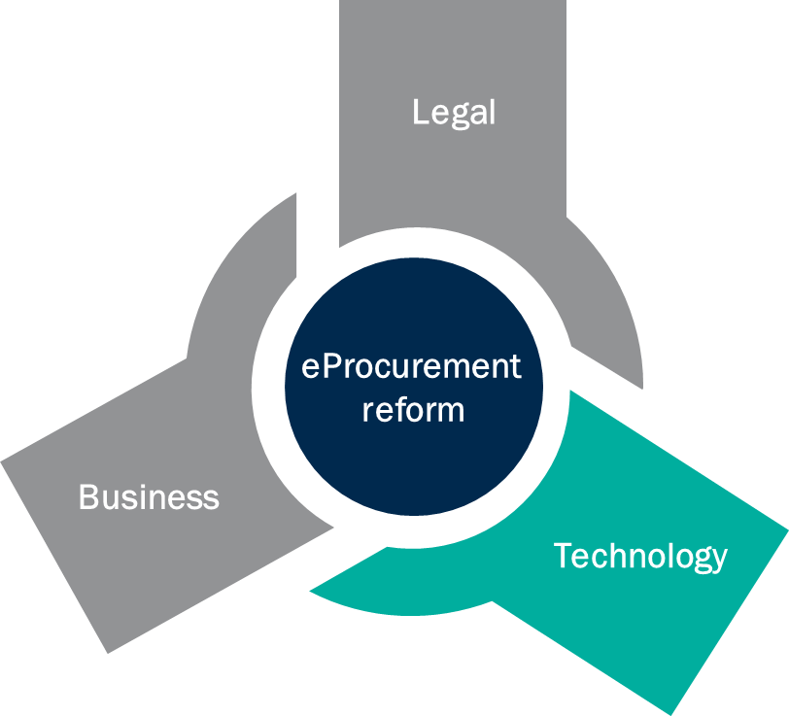
MTender - Technology decisions
Objectives of the component
Prevent lock-in of the government in the proprietary solution
Design an eProcurement service that is compliant with international best practice
Define an interoperability system that can interoperate with eGovernment services and registers
Use leading open source open data technologies
Use Open Government Data Standard and Open Contracting Data Standard (OCDS)
Proof of concept and Pre-commissioning pilots to verify feasibility of digital service on domestic market

Slide 46








Creating MTender
Tools and benefits
MTender pilot was created with OCDS solutions and tools applied to reap the maximum benefits of a modern digital procurement service
Tools to Apply Open Government in digital service
Benefits for stakeholders
Open source technologies
Improved accountability of procurement officers
Open Data for Government Standards (ODGS)
High level of transparency due to online real time procurement information
Open Contracting Data Standard (OCDS)
Enable data-driven public procurement process management
Real-time online communication and data exchange
Favourable market conditions for competition and increased participation for SMEs

Slide 47









Creating MTender
Main characteristics
MTender Phase 2 pilot tested flexible software and sustainable infrastructure
Based on global best practice in the 2011 UNCITRAL
Model Law on Public Procurement
Compliant with the 2012 WTO GPA and the 2014 European Union Directives on Public Procurement
Designed to be interoperable,
also with existing EU resources
(ESPD, TED)
Easy to customise to support procurement of different public and commercial buyers
Configurable central unit
for flexible procurement process
Innovative technologies: architecture and design of high scalability
Business process based on global procurement best practice 2011 UNCITRAL Model Law
Open Source
Open Data
technologies
Advanced
Open
Contracting Data
Standard inside
Security level in compliance with ISO 270001

Slide 48







Creating MTender
Advanced Open Contracting Data Standard PLUS (for EU Member States)
OCDS generates flexible, complete and re-usable data through an open data schema describing how to release documents and data at each stage of a procurement process.
Planning
Tender
Award
Contract
Implementation
Register
Information about the goals, budgets and projects a procurement process relates to.
Information about how a tender will take place, or has taken place
Information on awards made as part of a procurement process
Information on contracts signed as part of a procurement process
Information on the progress of each contract towards completion
Information about all concluded digital contracts, implementation and results

Slide 49





Creating MTender
Key Advantages - Open OCDS Networking Multi-Platform Digital Procurement
Modularity
Interoperable multi-platform networking
Open source technologies and open data
eProcurement resource for quality clean digital public procurement data
Creation of online procurement markets and data-driven service

Slide 50
Creating MTender
Key Advantages of the Open OCDS Networking Multi-Platform Digital Procurement
Provides potential for automation in context of diverging levels of available government services
Flexibility in terms of the use of various popular standard libraries of technical specifications, terms and conditions of contracts and framework agreements, award criteria and evaluation methodologies
Adaptable in terms of setting-up procurement cycle data management and permissions to use specific workflows of the system
Modularity
Can contribute to the creation of new digital procurement system or improvement of the eProcurement system/s, even where there are already established commercial or public sector platforms in operation
Can be used to create a network or community of jurisdictions with the OCDS digital procurement solutions
Can facilitate cross-border cooperation
Interoperable multi-platform networking
Public procurement data is cleaner, standardised, available and fully accessible for re-use as promoted by Open Contracting Partnership and other best practices promoters
The OCDS networking digital procurement system fulfils best practice recommendations and is learning from best practice implementations in the EU and beyond
Open source technologies and open data

Slide 51
Creating MTender
Key Advantages of the Open OCDS Networking Multi-Platform Digital Procurement
Open Government Approach results with clean procurement data that can serve equally all public procurement stakeholders, and allows for developing procurement market overviews and development of additional reputational tools
The civil-society oriented applications of the OCDS open data solutions allow for the development of sophisticated data analysis and detection of repetitive non-performance or non-compliance from a bottom-up perspective
The OCDS open data analytics solution has a transformative potential and can make a decisive contribution to the implementation of data-driven improvements to procurement
eProcurement resource for quality clean digital public procurement data
Due to its outstanding interoperability, the OCDS networking model is particularly suitable for creating online marketplaces
Market creation with OCDS-based digital procurement is possible because open data digital processes mean it is more likely to buy better quality for less money, with less effort
The design of OCDS networking digital procurement responds to policy actions recommendations to the EU Member States
The OCDS digital procurement networking system can be adapted to different market structures for the provision of (de)centralised e-procurement services and to different approaches to the funding or cost-allocation of the system
Creation of online procurement markets and data-driven service

Slide 52
Creating MTender
Key innovation aspects
The main key aspects of MTender as an innovative solution are depicted as follows:
The Web Portal encourages the participation in public tenders by providing a single point of access to literally all information on public procurement, online and in real time.
MTender creates a transparent relationship between the Government and the local business community by providing mechanisms such as the submission and publication of clarifications, the publication of tender results once the bidding is finished, etc.
MTender decreases the time of the procurement cycle by providing means to make the tendering process more agile, such as online submission of bidding documents or integration with state registers. It also establishes an automated qualification process that reduces the time required to evaluate and manage Economic Operators’ submitted data, consequently reducing the risk of administrative mistakes.
MTender currently integrates with the State Treasury, and in the future with other eGovernment services, with the objective of decreasing the processing time of tendering processes, removing conventional means of communication and providing quality data coming from the eGovernment services.
7 July, 2020

Slide 53
Creating MTender
Key innovation aspects
MTender implements a standardized procurement process with automated sub-processes to facilitate the management of different tending aspects (i.e. auction process).
The Central Database Unit is highly maintainable as it is decoupled from the Network Electronic Procurement Platforms and eGovernment services and operates as a centralized process manager. Furthermore, due to its decoupled nature, the CDU is also scalable and can be easily implanted to interact with new NEPPs.
The connection between the CDU and NEPPs is through an API created using Kafka, which is an asynchronous and bidirectional platform. This provides the initial advantage of a sender not having to wait for a receiver’s answer, therefore, improving the user experience by avoiding the negative impact of blocked processes.

Slide 54



Creating MTender
Legal Dimension to the Social and Economic Benefits
The MTender processes are aligned to the most recent EU legislation
Mtender implements techniques such as the Framework Agreement as modelled in the eForms, in all its phases within the eProcurement value chain.
E-Forms
Mtender is being prepared to interoperate with the eCertis Registry and Service Providers so ESPDs Requests with EU and National exclusion grounds and selection criteria can be built automatically and in a timely manner.
ESPD and e-Certis
The alignment promotes relevant policy aspects such as:
Greater participation from SMEs
Greater value for money
Once-Only-Principle, which implies better data quality
Notes:
The M-Tender processes are aligned to most recent EU legislation, notably:
eForms: The Commission Implementing Regulation (EU) 2019/1780 of 23 September 2019 establishing standard forms for the publication of noticies (EU) 2015/1986 (eFrorms) → Mtender implements techniques such as the Framework Agreement as modelled in the eForms, in all its phases within the eProcurement value chain.
ESPD and e-Certis. The Commission implementing Regulation (EU) 2016/7 of 5 January 2016 establishing the standard form for the European Single Procurement Document (ESPD) and the e-Certis registry providing support to the EU and National criteria and mapping MS types of evidences for cross-border procurement → Mtender is being prepared to interoperate with the eCertis Registry and Service Providers so ESPDs Requests with EU and National exclusion grounds and selection criteria can be built automatically and in a timely manner.
This alignment promotes relevant policy aspects such as:
Fostering the participation of SMEs
Greatly reducing the burden for both the public administration officers and the ecoomic operators, which enterils more value for money
Undertaking step towards the Once-Only-Principle, which implies data of great quality and usefulness

Slide 55



Creating MTender
Legal Dimension to the Social and Economic Benefits
The MTender data model can be aligned to the eProcurement Ontology eNotification and eAccess phases, which in turn are also aligned to the data models of eForms, the ESPD and the TED (Tenders electronic Daily, Publications Office of the European Union).
This alignment promotes several benefits.
The cross-border and cross-domain semantic interoperability with any system aligned to the EU legislation
The Transparency of the published harmonised procedures
The other cross-checking of national and international data for mid-term planning, anti-corruption and anti-fraud measures and policy
Notes:
From the technical dimensión to the political benefits:
The M-Tender data model will be aligned to the eProcurement Ontology e-Notification nad eAccess phases, which in turn are also aligned to the data models of eForms, the ESPD and the TED (Tenders electronic Daily, Publications Office of the European Union). This alignment promotes:
The cross-border and cross-domain semantic interoperability with any system aligned to the EU legislation, which contributes to….
The Transparency of the published harmonised procedures, which contributes to…
The other cross-checking of national and interational data for mid-term planning, anti-corruption and anti-fraud measures and polcy;
Other….

Slide 56
Creating MTender
MTender key values
MTender grants benefits to public procurement and helps achieving an increased efficiency of the processes and a better quality of the service
Increased transparency
1
2
Easy and quick start
Adaptability of procurement procedures
3
4
Facilitation of cross-border procurement
Automation of processes
5
Single window system
6
Quality of the service
7
Greater competition
10
Efficient maintenance for the government
Distributed
shared responsibility
8
9

Slide 57
Creating MTender
MTender key values
1
Easy and quick start
MTender is provided in a format that shortens the time to market by allowing the easy adoption, quick start and an affordable system for the countries or stakeholders interested in implementing it, while allowing for system adaptation to the local or specific context with minor adjustments
e.g. the system can be easily deployed in a different environment, with minor adjustments to processes or integration with third parties such as other e-government services
2
Increased transparency
MTender follows the ‘everyone sees everything’ principle, so all data and information on the public procurement procedure is made available, for free and in a reusable format
e.g. civil society can reuse public information on the procurement procedure to perform investigation and monitoring activities, for example, for controlling the quality of contracted services
3
Adaptability of procurement procedures
MTender implements procurement procedures compliant with international standards (UNCITRAL, WTO GPA, etc.), with workflows that can be adapted to the local practice or to specific needs
e.g. the workflow of public procurement procedures can be adjusted and some steps may be added, modified or eliminated depending on the localised practices

Slide 58
Creating MTender
MTender key values
4
Facilitation of cross-border procurement
Networking Electronic Platforms can be connected to different Central Units, even in different countries, therefore facilitating cross-border procurement through a unique environment
e.g. a NEPP can be connected to the central unit of two different countries, and the economic operators could participate in procurement procedures in those two countries with some minor adjustments to their workflow
5
Automation of processes
MTender decreases the time of the procurement cycle by providing means to make the tendering process more agile by automating certain tasks, reuses already existing public services information and avoids the duplicated submission of information, which also prevents administrative errors
e.g. several processes are automated, such as for example, the ranking of suppliers during the evaluation process, according to price and other criteria
6
Single window system
MTender replicates in real-time all information in all platforms, being that, de facto, each platform acts as a single window for the whole procurement process
e.g. any user can select any platform to interact with the procurement process, and economic operators are not required to use the same platform as the contracting authority they are tendering for

Slide 59
Creating MTender
MTender key values
7
Networking Electronic Platforms have incentives to increase the quality of the service as their business model is based on the participation of economic operators through their platform
Facilitation of cross-Quality of the service
border procurement
e.g. NEPPs can provide additional services to economic operators, or a better user experience through their platform in order to compete with the rest of NEPPs to attract more users
8
Efficient maintenance for the government
The Central Unit is easily maintained as it is decoupled from the Network Electronic Procurement Platforms and eGovernment services and operates as a centralized process manager. Additionally, the maintenance cost of the Central Unit is shared with the NEPPs, since part of the fees they collect are shared with the Central Unit operator
e.g. the cost of maintenance of the central unit and/or the unit in charge of eProcurement operation, can be fully covered by the fees collected from economic operators participating in public procurement

Slide 60
Creating MTender
MTender key values
9
Networking Electronic Platforms have incentives to increase the participation from economic operators as their business model relies on fees upon submission of bids, therefore, the greater the participation is in each procedure, the greater the fees they collect.
Greater competition
e.g. NEPPs are willing to perform greater promotional activities to attract more economic operators into the procurement process, so they collect more fees
10
Distributed
shared responsibility
MTender is both operated by the state administration and business, resulting in the responsibilities also being distributed amongst them
e.g. any of the stakeholders involved cannot decide on their own to modify a procurement procedure or the system workflow, so corruptive or abusive practices are avoided

Slide 61
Workshop agenda – 1st Day
Thursday 7th November
9.15 – 9.30 | Welcome and presentations
9.30 – 10.30 | EU Delegation project presentation TBC, EU Delegation representative
10.30 – 11.00 | EBRD Project presentation Xavier Quer, everis Reform objectives Stakeholders involved
11.00 – 11.30 | Coffee break
11.30– 13.00 | Business concept of the reform Daniel Arosa, everis Reform concept Reform principles Main pillars of the reform
13.00 – 14.30 | Lunch break
14.30 – 15.30 | Regulatory reform Dorina Harcenco, EBRD Baseline situation Harmonisation with EU acquis and GPA terms OCP transparency safeguards Secondary legislation implemented
15.30 – 16.30 | MTender presentation Xavier Quer, everis; Daniel Arosa, everis MTender concept Main key aspects of MTender MTender implementation plan
16.30 – 17.00 | Closing remarks Xavier Quer, everis

Slide 62
Closing remarks
Any questions?

Slide 63
Workshop agenda
Friday 8th November
Day 2
Presentation of the MTender pilot Implementation Phase 2 system pilot in detail and the document repository of the EBRD TC reform

Slide 64
Workshop agenda – 2nd Day
Friday 8th November
14.30 – 16.00 | MTender presentation (interactive session with questions and answers) Paul Boroday, uStudio; Daniel Arosa, everis Available functionalities Pilot status Impact and results NEPPs Available functionality in MTender Pilot Phase 2
16.00 – 16.15 | Coffee break
16.15 – 16.30 | MTender TC documentation repository
16.30 – 17.00 | Closing remarks Xavier Quer, everis Questions and answers

Slide 65
MTender
MTender pilot main characteristics
The main modules and characteristics of the Central Database Unit are depicted as follows:
ePlanning
ePlanning allows Contracting authorities to better organise their procurement needs and aggregate purchases to maximise efficiency
The Central Database allows for real-time communication and information exchange within all eProcurement platforms, while keeping full traceability of the public procurement process
Central
Database
eContract Management
This module allows the control of the contract execution, including the launch of second competition procedures within framework agreements, payments and invoicing
Integration with eGovernment tools to take advantage of a modern and already tested eGovernment environment, which reduces the need of deploying other alternative solutions
eGovernment tools
eAuction
Advanced eAuction functionality that allows not only for evaluation based on lowest price criteria but also for other quality criteria and a semi- automated evaluation of bids
Government registers
Integration with several government registers in order to reduce the need of inputting information manually and automatise administrative checks

Slide 66
MTender
MTender implementation pilot
MTender implementation is organised in different pilots, which were running in parallel, covering different public procurement procedures
Pilot 1 – micro value procurement
April 2017 – April 2019
Implementation of eProcurement procedures for micro purchases, in order to test the eProcurement concept in a controlled and low-risk environment, with no need to reform the public procurement legislation
Re-use of the Ukraine Prozorro solution for the implementation of eProcurement for micro value procedures, when feasible
Pilot 2 – small and high value procurement
October 2018 – December 2019
Implementation of request for quotation and open tender for small and high value procurement
Implementation of multi-criteria eAuction for evaluation and semi-automated ESPD qualification
Generation and signature of online contracts, and registration in the Treasury
Pilot 3 – restricted procedure
Functionality under development
Implementation of restricted tender to comply with GPA obligations with Annex 3 entities

Slide 67
MTender
MTender implementation pilot - Functionalities development status
The following functionalities are foreseen to be implemented in the MTender system. The MTender pilot has already made progress on their development
Functionality | Features implemented in the pilot
Web portal | Web portal will be accessible from the most common web browsers that contains relevant information on public procurement and MTender The portal acts as a point of single contact for accessing public tenders (once-only principle).
ePlanning | Creation, modification, approval and publication of Annual Procurement Plans. The plan covers all mandatory information required for TED Buyer’s profile and prior information notice (PIN). Access to state budget systems for planning purposes – validation Procedures initiated from current and new plan for next year annual plan
eAccess | Preparation, modification and cancellation of tendering procedures, including definition of requirements, attaching tender documentation and provision of awarding method. It allows the orchestration of request for quotation for goods and services with mandatory auction, and quotation for works, with facultative auction Negotiated and paper procedures without notice – UNDER DEVELOPMENT
eNotices | Preparation of localised version of TED e-notices (online notice template) for open tender, request for quotation and micro value procedures, including: contract notice, contract award notice, contract registration notice and corrigendum notice.
eClarification | Out of scope of the pilot
Cabinets for single users | Out of scope of the pilot

Slide 68
MTender
MTender implementation pilot - Functionalities development status
Functionality | Features implemented in the pilot
eSubmission | Online submission implemented for all tendering procedures
e-Qualification | Pass/Fail Online ESPD I-IV integrated with MConnect, including Treasury Systems but manual Tax Record, Criminal Record, Blacklisting Register Pass/Fail Online ESPD I-III integrated with MConnect, including Treasury Systems but manual Tax Record, Criminal Record, Blacklisting Register Online ESPD Part III-IV (pass/fail) prepared for automation (integration with MConnect and Treasury Systems in progress), except for manual inputs from Criminal record, Tax record and blacklisting register (no digital version available in MConnect).
eAuction | Implementation of different auction types: Lowest price auction automated; Lowest cost – enabled, but not automated (offline evaluation); Price and other criteria – enabled, but not automated (offline evaluation); – UNDER DEVELOPMENT Automated multi attribute auction. – UNDER DEVELOPMENT
eAwarding | Preparation of awarding data for generation of award notices (positive or negative) and provision of data for contracts for registration.
Document management | Tender packages (envelope scheme for online submissions) for price only and price and other criteria Document Workflow Manager – UNDER DEVELOPMENT
eMonitoring (BI) | OCDS export from transactional database for planning, tendering and contract register

Slide 69
MTender
MTender implementation pilot - Functionalities development status
Functionality | Features implemented in the pilot
eEvaluation – for no auction | It implements different types of evaluation: 1) Price ranking – automated ranking by lowest price in electronic reverse auction; 2) Price ranking – automated ranking by lowest price from Tender Form when electronic auction is not used for evaluation; 3) Price and other criteria with technical scoring –offline evaluation by tender committee is reported by procurement officer to the system by filling in evaluation forms and uploading scans of hard copy documents signed by tender committee; 4) Lowest cost ranking with value inputs by supplier in Tender Form, when no auction is used – automated ranking by sum of cost components from Tender Form – UNDER DEVELOPMENT 5) Price and other criteria with value inputs by supplier in Tender Form, when no auction is used - automated ranking by sum of values from Tender Form – UNDER DEVELOPMENT 6) Price and other criteria with value inputs by supplier during electronic auction – automated evaluation of price and other criteria – UNDER DEVELOPMENT
eComplaint | Enforced standstill period after publication of notice of award Reported complaint received during standstill period needs to trigger automated suspension of procedure Decision on complaint reported to the system should automatically release procedure from suspension
eRegistration | Registration of users in the MTender system (through NEPPs) and update profile information

Slide 70
MTender
MTender implementation pilot - Functionalities development status
Functionality | Features implemented in the pilot
eContract Management | Generating electronic contract document of contract for three types of contracts: goods, works, services, on updated contract templates from and available information on the system from completed open tender and manually imputed information, when not available on the system, Online signature with MSign, Validating budget (IBAN) with the Treasury using MConnect Contract performance guarantee – offline, not digitalised and not automated Registration of the public contract in the Treasury and public contract register No separate workflow for registration of changes to public contract – the Treasury requested amendments and extensions to be generated as new contracts and registered in the Treasury as a new contracts. To achieve accurate data for compliance check and financial control, the Treasury is responsible for linking original contract ID with amendment or revision ID, to create a contract record and report it back to MTender contract register. Generating and online signing aggregated contract for multi-lot procedures (merged contracts)
eAuthentication | Authentication of users in the MTender system (through NEPPs) once their credentials are provided
eNotification | Receive notifications based on events occurring in the system (through NEPPs).
eInvoicing | Out of scope of the pilot

Slide 71
MTender
On-going pilot development
The following functionalities are currently being developed and will be deployed in the sandbox environment of MTender by the end of 2019
1
Offline procedures
Pilot 2
2
Document workflow management
Pilot 2
3
Automated evaluation on non-price criteria based on supplier inputs and Automated evaluation on non-price criteria for the scoring of the tender committee
Pilot 2
4
Multi-criteria eAuction, which covers not only price but also other criteria
Pilot 2
5
GPA procedure, including restricted tender
Pilot 3

Slide 72




MTender impact and results
Cost sharing model: small investments, big returns
The implementation of the MTender system has required minimum investment from the Government of the Republic of Moldova
MCloud hosting
100,000
Estimated MTender commercial partners investment (in EUR)
State budget investment
580,000
100,000
Total EBRD TC investment (in EUR)
Total other TC donors investment WNISEF, OCP, UNDP (in EUR)
The future maintenance of the system should be based on a fee-based operation cost model and collaborative development.

Slide 73




MTender impact and results
MTender uptake
MTender uptake has been a success within contracting authorities and in attracting SMEs
Public sector
Economic operators
2,893
791
4,670
49%
Public sector contracting authorities
Contracting authorities who advertised public procurement in competitive procedures
Participating suppliers
Participating SME suppliers: 2302

Slide 74





MTender impact and results
MTender main figures
More tan 4 billion MDL have been awarded through MTender.
Only 30% of public contracts awarded in competitive selection
12 months total estimated value of public contracts
Non - competitive procedures
Competitive procedures
Total
MDL 4,155,900,000.00
(EUR 214,423,660.50)
MDL 3,340,000,000.00
MDL 815,900,000.00
Web portal Public Contract Register
Advertised public procurement - competitive selections
Tenders with electronic reverse auction (e-Auction)
15,474
3,237
49,302
Awarded electronic competitive tenders
Tenders in progress
6,982
2,774

Slide 75
MTender impact and results
MTender – fostering participation and savings
MTender is saving on average 10% compared to estimated price, as published by the contracting entity
Average number of bidders per lot | Standard | 1.9
 | Electronic reverse auction | 2.1
Estimated state budget savings from competitive procedures | EUR 24,966,095.50
Total savings in completed e-Auctions | EUR 28,823,218.00
e-Auctions’ effectiveness | 4,7%

Slide 76
MTender impact and results
MTender – Pilot impact
MTender has contributed to a more competitive public procurement market in Moldova with less entry barriers
Six times more contracting authorities using eProcurement and using more advanced eProcurement functionalities
Twenty times more public procurement procedures recorded online on the web portal
Six times more procurement advertised online and subject to competition and Five times more public contracts registered
Reduced tender value per procurement procedure, resulting in lower market concentration and increased SMEs participation
1396 new suppliers participated in MTender electronic tenders (30 per cent increase)

Slide 77
Workshop agenda – 2nd Day
Friday 8th November
14.30 – 16.00 | MTender presentation (interactive session with questions and answers) Paul Boroday, uStudio; Daniel Arosa, everis Available functionalities Pilot status Impact and results NEPPs Available functionality in MTender Pilot Phase 2
16.00 – 16.15 | Coffee break
16.15 – 16.30 | MTender TC documentation repository Daniel Arosa, everis
16.30 – 17.00 | Closing remarks Xavier Quer, everis Questions and answers

Slide 78
MTender
Dissemination
MTender is going to be provided as an open source solution that any interested stakeholder can implement. For ensuring such opportunity, a dedicated GitHub space has been set, where the project is explained and the source of the solution is published
MTender GitHub
https://github.com/MTendereProcurementSystem/MTender/wiki

Slide 79
Workshop agenda – 2nd Day
Friday 8th November
14.30 – 16.00 | MTender presentation (interactive session with questions and answers) Paul Boroday, uStudio; Daniel Arosa, everis Available functionalities Pilot status Impact and results NEPPs Available functionality in MTender Pilot Phase 2
16.00 – 16.15 | Coffee break
16.15 – 16.30 | MTender TC documentation repository
16.30 – 17.00 | Closing remarks Xavier Quer, everis Questions and answers

Slide 80
Closing remarks
Next steps
1/
EBRD project to provide further project documentation as needed
2/
EU Delegation to review MTender system and associated documentation
3/
EBRD project team to assist the EU Delegation team in adopting MTender

Slide 81
Closing remarks
Any other questions or doubts?

Slide 82
Contact Details
Thank you for your attention!
Contact
Eliza Niewiadomska | Legal Transition Programme - Public Procurement | NiewiadE@ebrd.com

